Slide 1

Labour Law - The Code on Wages 2019
By Harshul Bangia

Slide 2
SYNOPSIS
Understanding labour law and the need for reforms.
Aim of the Wage Code
Legislation Repealed
Definitions
Payment of Wages (time, mode, etc)
Computation of Wages
Responsibility of Employers under wage code
Inspection
Penalties
Handy tips for employers

Slide 3
WHAT IS LABOUR LAW?
Labour law, the varied body of law applied to such matters as employment, remuneration, conditions of work, trade unions, and industrial relations.
In its most comprehensive sense, the term includes social security and disability insurance as well.

Slide 4
LABOUR LAW REFORMS
Most laws were inherited from British Rule.
The speed of making changes was very slow.
In 1970s, labour laws were restricted to manufacturing sector.
Current labour laws protect only 40% of the organised workforce.
The unorganised sector was not looked upon.

Slide 5
LABOUR LAW REFORMS
2nd Law Commission on Labour was set-up in 1999 which suggested rationalization of existing laws.
The Commission submitted it’s report in 2002 and recommended amalgamating the current labour laws into following groups:

Slide 6
LABOUR LAW REFORMS
Industrial Relation
Wages
Social Security
Safety
Welfare and Working Conditions

Slide 7
AIM/BENEFITS OF THE WAGE CODE
To Amalgamate, simply and rationalise provisions of the laws repealed.
Clarity on the concepts of
  Employment
  Wages
  Applicability

Slide 8
LEGISLATIONS REPEALED
The Code replaces the following four laws:
the Payment of Wages Act, 1936,
the Minimum Wages Act, 1948,
the Payment of Bonus Act, 1965, and
the Equal Remuneration Act, 1976.

Slide 9
AIM/BENEFITS OF THE CODE
Rationalise the number of compliances.
Allow digital transaction and online payments.
Reduce Conflicts and confusion over multiplicity of definitions.
Broadening the concept of employers and employers
Eliminate the complexity of having Central laws, State Laws and their rules.

Slide 10
DEFINITIONS UNDER THE CODE
1. ESTABLISHMENT – It means any place where any industry, trade, business, manufacture or occupation is carried on and includes Government establishment.

Slide 11
DEFINITIONS UNDER THE CODE
2. EMPLOYEE – It means, any person (other than an apprentice engaged under the Apprentices Act, 1961), employed on wages by an establishment to do any skilled, semi-skilled or unskilled, manual, operational, supervisory, managerial, administrative, technical or clerical work for hire or reward, whether the terms of employment be express or implied, and also includes a person declared to be an employee by the appropriate Government, but does not include any member of the Armed Forces of the Union

Slide 12
DEFINITIONS UNDER THE CODE
3. WORKER – means any person (except an apprentice as defined under clause (aa) of section 2 of the Apprentices Act, 1961) employed in any industry to do any manual, unskilled, skilled, technical, operational, clerical or supervisory work for hire or reward, whether the terms of employment be express or implied.

Slide 13
DEFINITIONS UNDER THE CODE
4. EMPLOYER - means a person who employs, whether directly or through any person, or on his behalf or on behalf of any person, one or more employees in his establishment and where the establishment is carried on by any department of the Central Government or the State Government, the authority specified, by the head of such department, in this behalf or where no authority, is so specified the head of the department and in relation to an establishment carried on by a local authority, the chief executive of that authority.

Slide 14
DEFINITIONS UNDER THE CODE
5. WAGES - means all remuneration whether by way of salaries, allowances or otherwise, expressed in terms of money or capable of being so expressed which would, if the terms of employment, express or implied, were fulfilled, be payable to a person employed in respect of his employment or of work done in such employment, and includes,— (i) basic pay; (ii) dearness allowance; and (iii) retaining allowance, if any.

Slide 15
WAGES DOESN’T INCLUDE -
Bonus
HRA
PF
Travelling concession
Overtime allowance
Gratuity
Commission payable, etc

Slide 16
NATIONAL MINIMUM WAGE – FLOOR WAGE
Points to be considered while fixing the minimum wage.
  Skills of workers – unskilled, semi-skilled, highly skilled.
  Geographical area
  Arduousness of work such as temperature/humidity, etc
  Cost of living index
Consultation with the State Government and Central Advisory Board.

Slide 17
NATIONAL MINIMUM WAGE – FLOOR WAGE
KEY POINTS
  Floor Wage to be prescribed State/Geographical Area Wise.
  State Minimum Wages has to be more than or equals to Floor Wage.
  States are restricted from lowering the existing Minimum Wage to match the Floor Wage.

Slide 18
EMPLOYEES ENTITLEMENT TO FULL WAGES
In case an employee works for lesser number of hours on a given day for reasons not attributable to the employee, then such employee will be entitled to get full days wage.
EXCEPTION – unless failure to work is caused by such employee’s unwillingness to work.

Slide 19
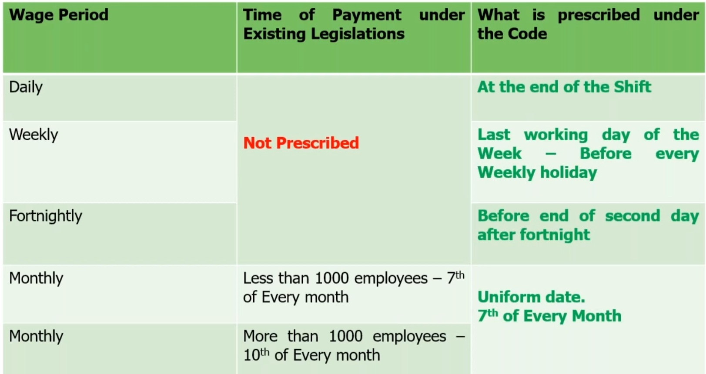
TIME FOR PAYING WAGES

Slide 20
MODE OF PAYMENT OF WAGES
Current coins or
Currency notes or
Cheque or
Crediting in Bank Account.
Payment through electronic mode.
* Bonus to be paid only electronically in bank account.
* In case of resignation, payment has to be made in 2 working days.

Slide 21
EQUAL RENUMERATION
There shall be no discrimination in an establishment or any unit thereof among employees on the ground of gender in matters relating to wages by the same employer, in respect of the same work or work of a similar nature done by any employee

Slide 22
OVERTIME PAYMENT
Minimum rate is 2 times the normal rate of wages.
State Government to fix overtime rate but not below double the rate of normal wages.

Slide 23
ELIGIBILITY FOR BONUS
Minimum employees should be 20 for entitlement for Bonus in an organisation.
Paid to every employee who has put in at least thirty days work in an accounting year, an annual minimum bonus calculated at the rate of eight and one-third per cent. (8 1/3 %) of the wages earned by the employee or one hundred rupees, whichever is higher.

Slide 24
DISQUALIFICATION FROM BONUS
(a) fraud; or
(b) riotous or violent behaviour while on the premises of the establishment; or
(c) theft, misappropriation or sabotage of any property of the establishment; or
(d) conviction for sexual harassment

Slide 25
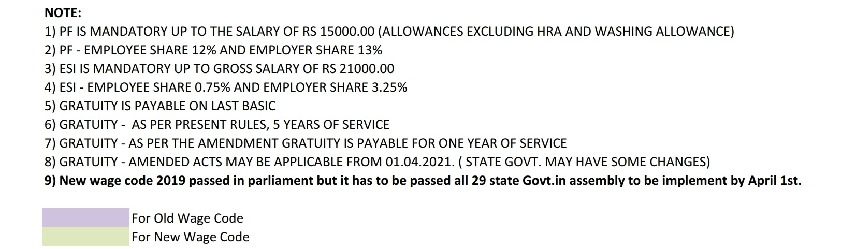
COMPUTATION OF WAGES

Slide 26
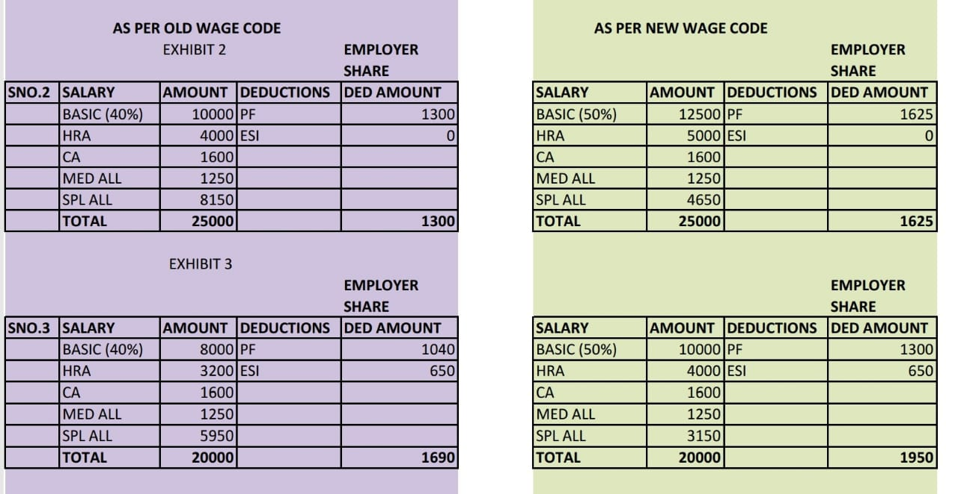
COMPUTATION OF WAGES

Slide 27
INCREASED RESPONSIBILITY FOR EMPLOYERS
BURDEN OF PROOF –
Where a claim has been filed on account of non-payment of remuneration or bonus or less payment of wages or bonus or on account of making deductions not authorised by this Code from the wages of an employee, the burden to prove that the said dues have been paid shall be on the employer.

Slide 28
INCREASED RESPONSIBILITY FOR EMPLOYERS
Organisation have to maintain proper documents relating to rate of wages, wages paid, bonus paid, etc.
All records have to be preserved for a minimum period of 3 years.

Slide 29
INSPECTION UNDER THE CODE
Inspection to be Web-based, where information to be sought for electronically.
Appointment of Inspector-cum-Facilitator irrespective of geographical limits.
Randomized selection of inspection.

Slide 30
OBJECTIVES OF INSPECTION
ADVICE
INSPECT
EXAMINE
SEIZE
* Employer will now get an opportunity to Rectify the error/ non-compliance pointed out by the Inspector and Comply with the code.

Slide 31
REVISED PENALTIES
After the chance of rectification, penalty might be imposed.
On paying less wages than the amount due to employees –
  1st offence – Rs. 50,000
  2nd offence (within 5 years) – Rs, 1,00,000 or 3 month imprisonment, or both.
On contravening any provision of the code –
  1st offence – Rs, 20,000
  2nd offence – Rs. 40,000 or 1 month imprisonment, or both.
Non-maintenance of records – Rs. 10,000

Slide 32
EXEMPTION OF EMPLOYER FROM LIABILITY
the employer proves to the satisfaction of the court—
(a) that he has used due diligence to enforce the execution of this Code; and
(b) that the said other person committed the offence in question without his knowledge, consent or connivance,

Slide 33
HANDY TIPS FOR EMPLOYERS
The code is applicable to all establishments
Many unorganised sector employees will now get minimum wages.
The new definition is expected to reduce litigation and cost of compliance.
No discrimination on payment of wages on grounds of gender.

Slide 34
HANDY TIPS FOR EMPLOYERS
5. Central government will fix the floor wage. Accordingly, the State government will fix wages not below the floor wage. So, employers have to choose the minimum wage according to the wages set by the appropriate government.
Wages to be paid only via digital payment or cheques.
Deductions can be made from wages, but shall not exceed 50%.

Slide 35
HANDY TIPS FOR EMPLOYERS
8. Payment of overtime shall not be less than double the rate of ordinary wages.
9. Bonus is payable, if the employer engages 20 or more employees.
10. Employer should co-operate Inspector-cum-facilitator.
11. A register with details regarding to persons employed, muster roll, wages, etc must be maintained.

Slide 36
HANDY TIPS FOR EMPLOYERS
12. Employer shall display a notice on the notice board containing:
Abstract of this code
Category-wise wages rates of employees
Wage period
Day or date and time of payment of wages
Name and address of Inspector-cum-Facilitator having jurisdiction.

Slide 37
HANDY TIPS FOR EMPLOYERS
13. Wages slips should be issued in manner prescribed.
14. With consolidation of 4 wage laws, maintain of records and register is reduced.
15. Limitation period for filing claims relating to wages and bonus has enhanced to 3 years.
16. Penalty for non-compliance has been enhanced.
17. Employer can seek advice of Inspector-cum-facilitator to ensure compliance and guidance on any matter related to this code.

Slide 38
QUESTION AND ANSWER SESSION

